Slide 1
Speech Autoencoder using Fully-Connected Neural Networks
Andrew Seagraves
1/4/19

Slide 2
Implementation Summary
Vanilla autoencoder built using Keras/TensorFlow
Custom pipeline for pre-processing and on-the-fly batch generation
Specialized utility functions for training on LibriSpeech corpuses
Mini-batches generated by traversing the raw audio signal for each speaker and breaking it into chunks of a specified size which become the feature vectors.
Overlap permitted between adjacent input chunks as a means for incorporating temporal structure into the autoencoder.
Driver implemented for automated hyperparameter studies

Slide 3
Pre-processing Workflow
build_speech_dict.py
Generates a “speech_dict” data structure from the corpus
Mirrors the internal structure of the LibriSpeech corpus. Useful for traversing the speakers, chapters, and utterances.
Concatenates each speaker’s utterances into a master 1D numpy array for the speaker. Writes array to disk.
The sequence of the utterances is preserved in the array.
Speaker array used for on-the-fly batch generation

Slide 4
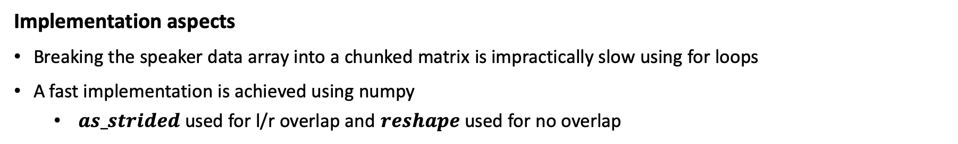
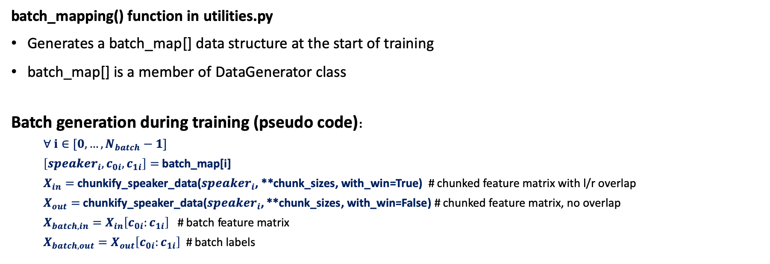
Batch Generation Workflow
batch_mapping() function in utilities.py
Generates a batch_map[] data structure at the start of training
batch_map[] is a member of DataGenerator class
Batch generation during training (pseudo code):
$∀$ $i∈[0,…,N_{batch}−1]$
$\left[{speaker}_{i}, c_{0i},c_{1i}\right]=$ batch_map[i]
$X_{in}=$ chunkify_speaker_data(${speaker}_{i}$, **chunk_sizes, with_win=True) # chunked feature matrix with l/r overlap
$X_{out}=$ chunkify_speaker_data(${speaker}_{i}$, **chunk_sizes, with_win=False) # chunked feature matrix, no overlap
$X_{batch,in}=X_{in}\left[c_{0i}:c_{1i}\right]$ # batch feature matrix
$X_{batch,out}=X_{out}\left[c_{0i}:c_{1i}\right]$ # batch labels
Implementation aspects
Breaking the speaker data array into a chunked matrix is impractically slow using for loops
A fast implementation is achieved using numpy
$as_strided$ used for l/r overlap and $reshape$ used for no overlap

Slide 5
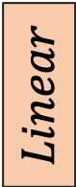


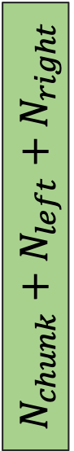

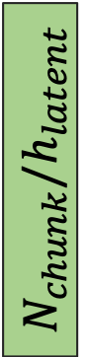



Example Network Architecture (5 layers)
Input audio chunk with left/right overlap
$$ReLU$$
$$ReLU$$
$$N_{chunk}$$
Predicted audio chunk
$$N_{chunk}+N_{left}+N_{right}$$
$$N_{chunk}/h_{2}$$
$$ReLU$$
$$Linear$$
$$N_{chunk}/h_{1}$$
$$N_{chunk}/h_{latent}$$
Encoder
Decoder

Slide 6
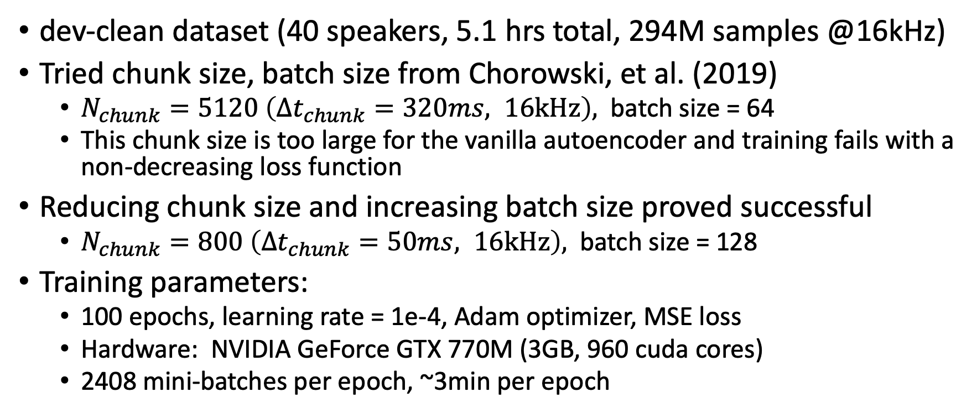
Training Experiments on Small Corpus
dev-clean dataset (40 speakers, 5.1 hrs total, 294M samples @16kHz)
Tried chunk size, batch size from Chorowski, et al. (2019)
$N_{chunk}=5120 \left({Δt}_{chunk}=320ms, 16kHz\right),$ batch size = 64
This chunk size is too large for the vanilla autoencoder and training fails with a non-decreasing loss function
Reducing chunk size and increasing batch size proved successful
$N_{chunk}=800 \left({Δt}_{chunk}=50ms, 16kHz\right),$ batch size = 128
Training parameters:
100 epochs, learning rate = 1e-4, Adam optimizer, MSE loss
Hardware: NVIDIA GeForce GTX 770M (3GB, 960 cuda cores)
2408 mini-batches per epoch, ~3min per epoch

Slide 7
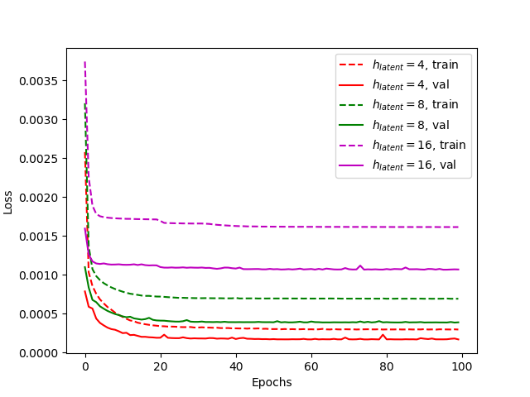
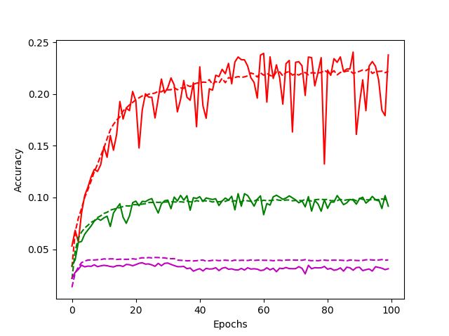
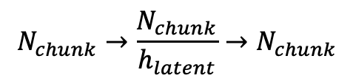
3-layer network – training results
$$N_{chunk}→\frac{N_{chunk}}{h_{latent}}→N_{chunk}$$

Slide 8
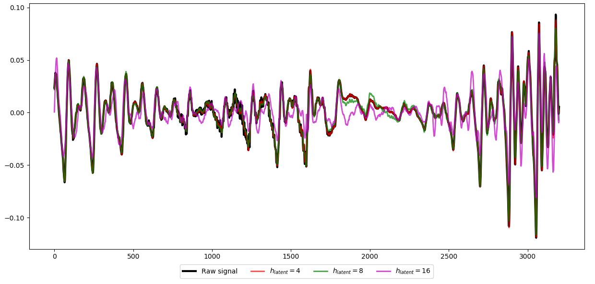

3-layer network
Speaker 2803
250ms audio sample (5 chunks)
$$N_{chunk}→\frac{N_{chunk}}{h_{latent}}→N_{chunk}$$
Comparison of ground truth and reconstructed audio signals (model checkpoint with highest val_acc)

Slide 9
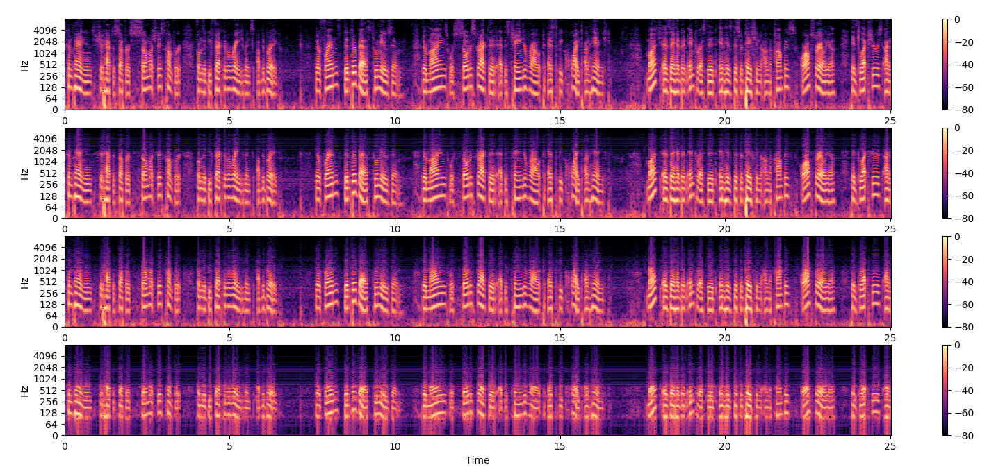
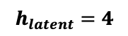
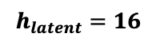
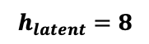
3-layer network
Speaker 2803
25s audio sample, log-spectrogram
Ground
Truth
$$h_{latent}=4$$
$$h_{latent}=8$$
$$h_{latent}=16$$

Slide 10
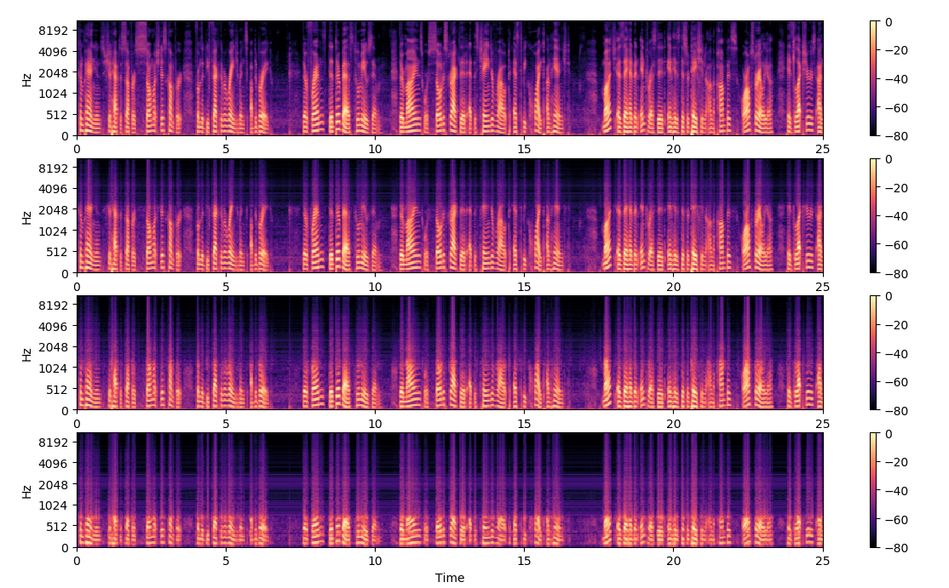
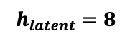
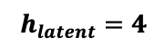
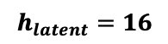
3-layer network
Speaker 2803
25s audio sample, mel-spectrogram
Ground
Truth
$$h_{latent}=4$$
$$h_{latent}=8$$
$$h_{latent}=16$$

Slide 11
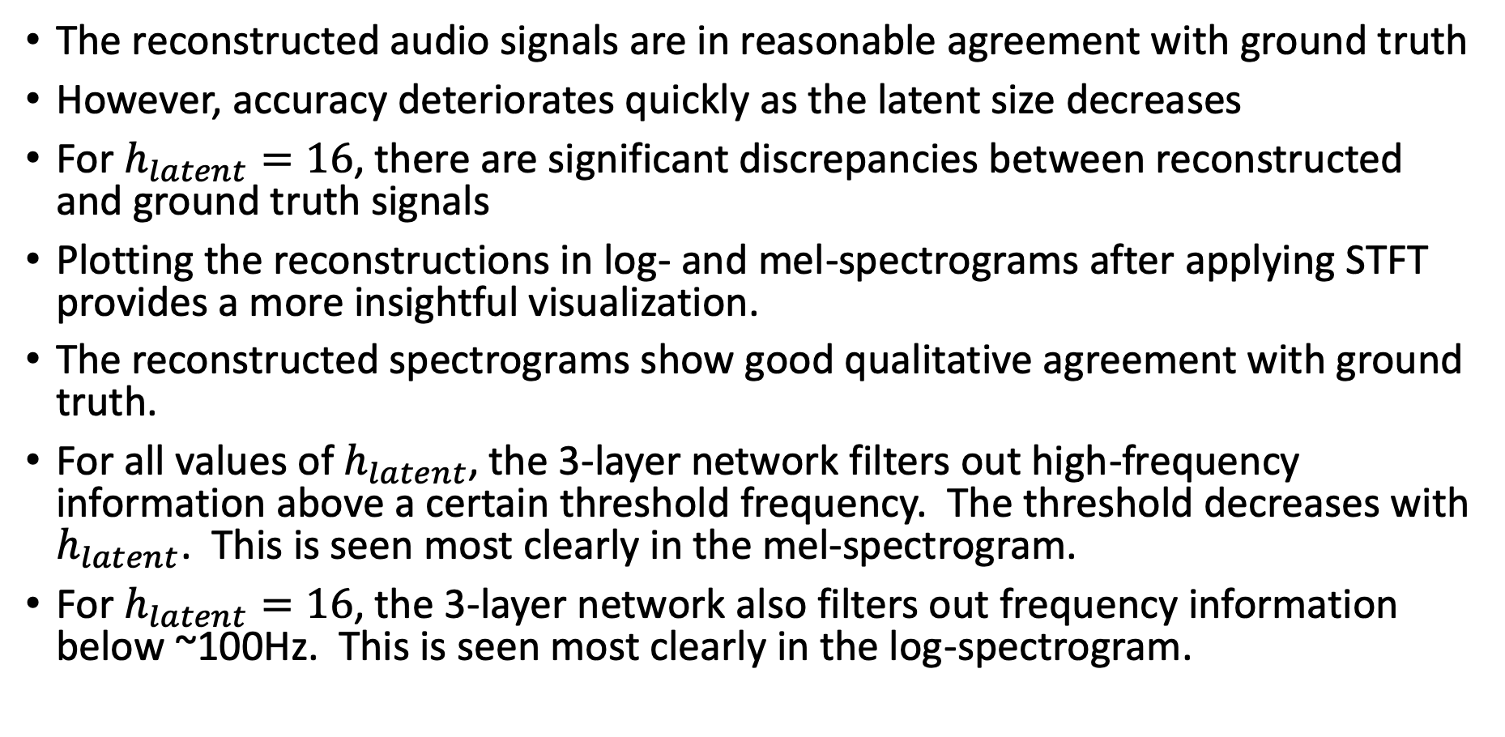
3-layer network - observations
The reconstructed audio signals are in reasonable agreement with ground truth
However, accuracy deteriorates quickly as the latent size decreases
For $h_{latent}=16$, there are significant discrepancies between reconstructed and ground truth signals
Plotting the reconstructions in log- and mel-spectrograms after applying STFT provides a more insightful visualization.
The reconstructed spectrograms show good qualitative agreement with ground truth.
For all values of $h_{latent}$, the 3-layer network filters out high-frequency information above a certain threshold frequency. The threshold decreases with $h_{latent}$. This is seen most clearly in the mel-spectrogram.
For $h_{latent}=16$, the 3-layer network also filters out frequency information below ~100Hz. This is seen most clearly in the log-spectrogram.

Slide 12
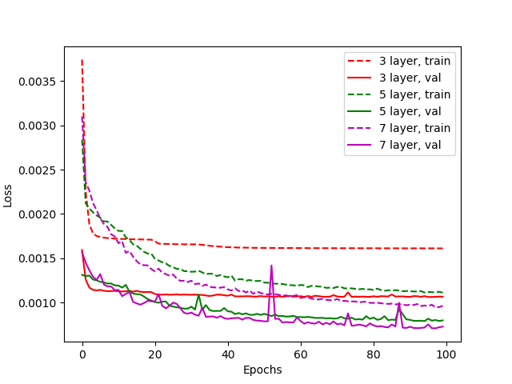
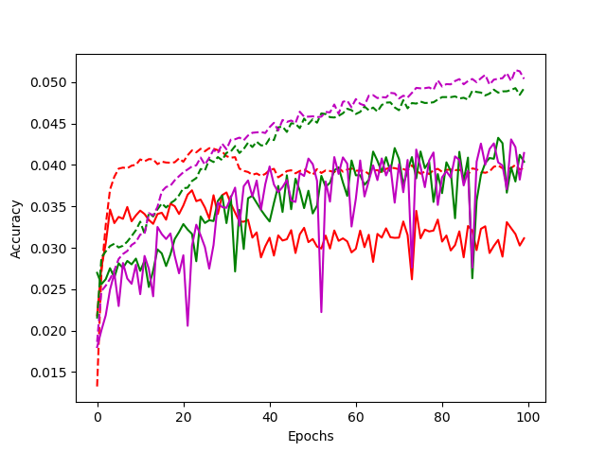
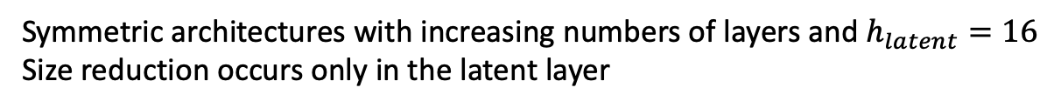
Increasing network depth
Symmetric architectures with increasing numbers of layers and $h_{latent}=16$
Size reduction occurs only in the latent layer

Slide 13
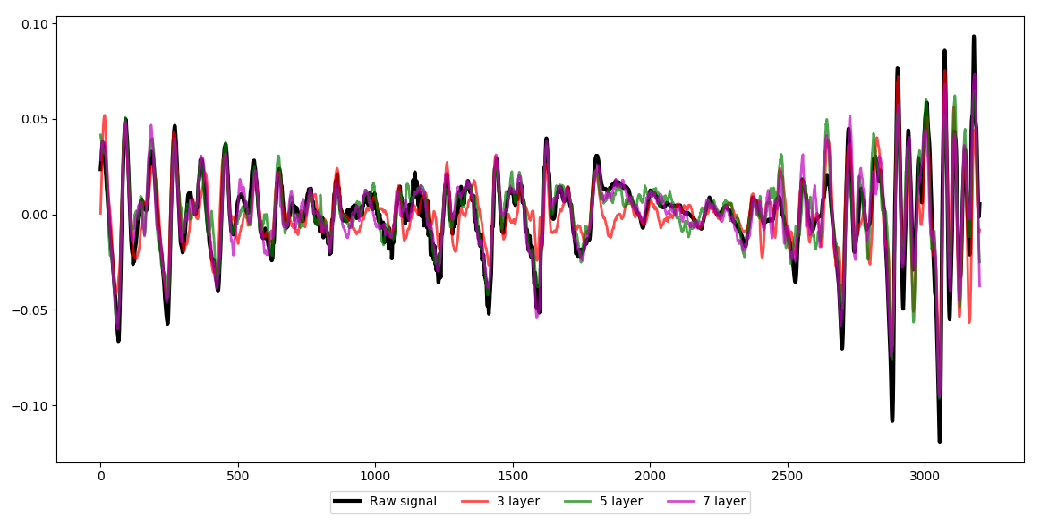
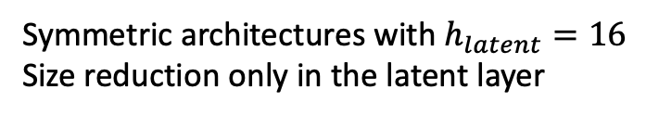
Increasing network depth
Speaker 2803
200ms audio sample (4 chunks)
Symmetric architectures with $h_{latent}=16$
Size reduction only in the latent layer
Comparison of ground truth and reconstructed audio signals (model checkpoint with highest val_acc)

Slide 14
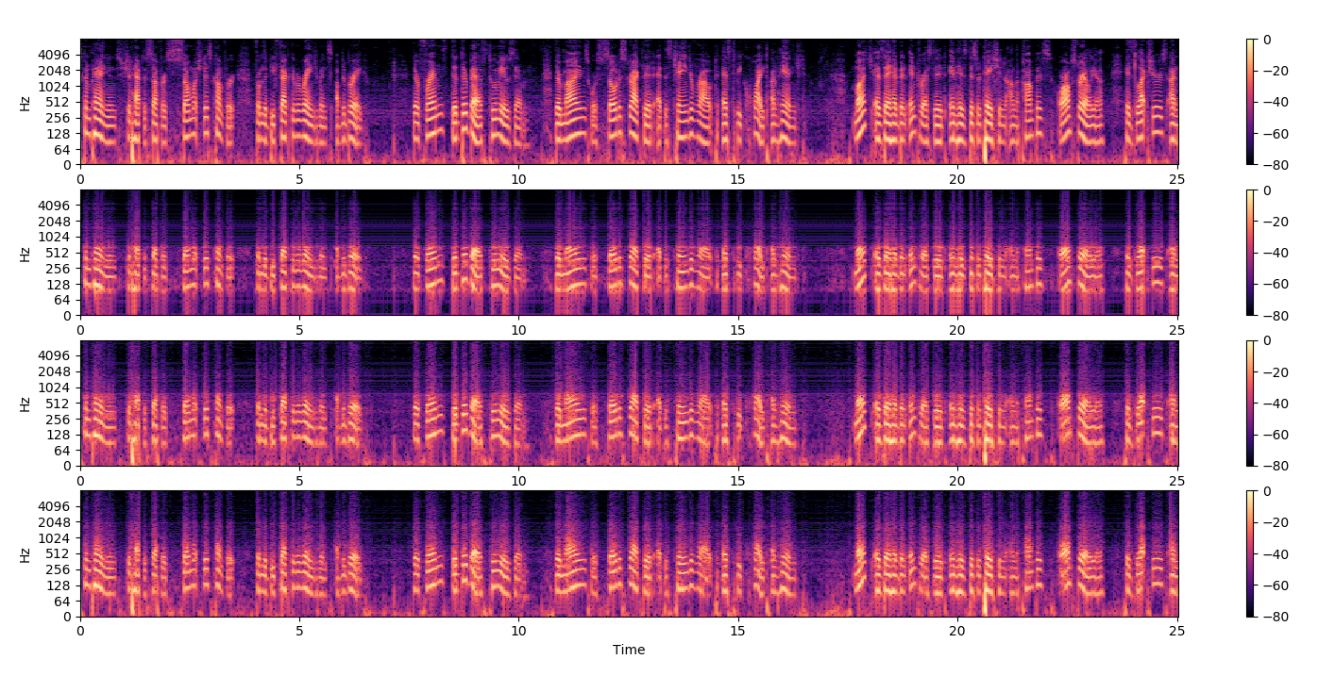
Increasing network depth
Speaker 2803
25s audio sample, log-spectrogram
Ground
Truth
3 Layers
5 Layers
7 Layers

Slide 15
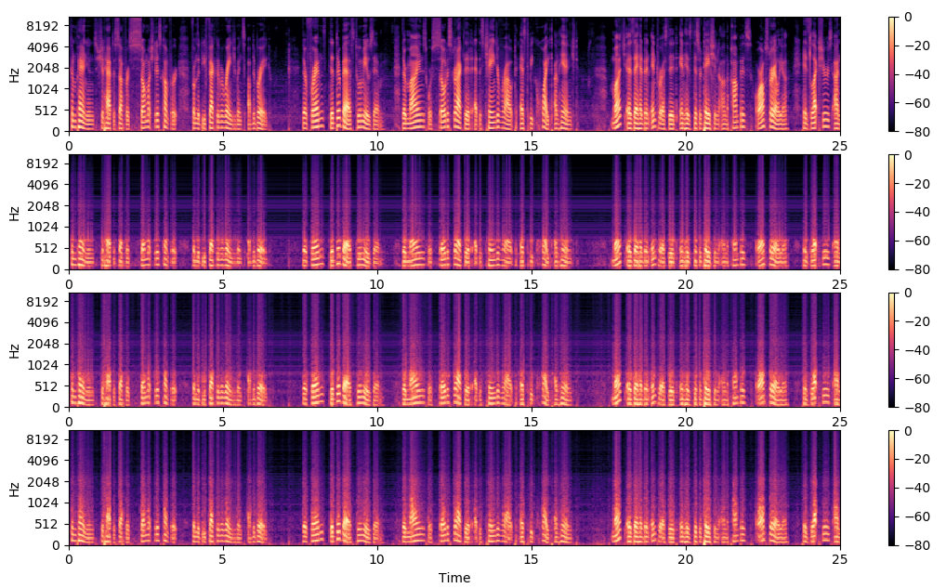
Increasing network depth
Speaker 2803
25s audio sample, mel-spectrogram
Ground
Truth
3 Layers
5 Layers
7 Layers

Slide 16
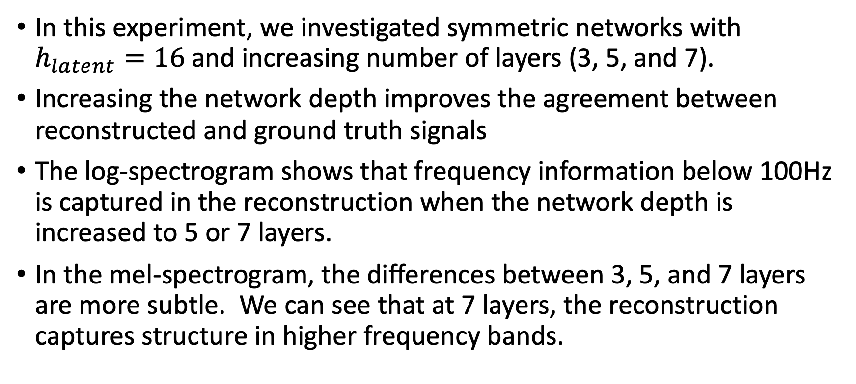
Increasing network depth - observations
In this experiment, we investigated symmetric networks with $h_{latent}=16$ and increasing number of layers (3, 5, and 7).
Increasing the network depth improves the agreement between reconstructed and ground truth signals
The log-spectrogram shows that frequency information below 100Hz is captured in the reconstruction when the network depth is increased to 5 or 7 layers.
In the mel-spectrogram, the differences between 3, 5, and 7 layers are more subtle. We can see that at 7 layers, the reconstruction captures structure in higher frequency bands.

Slide 17
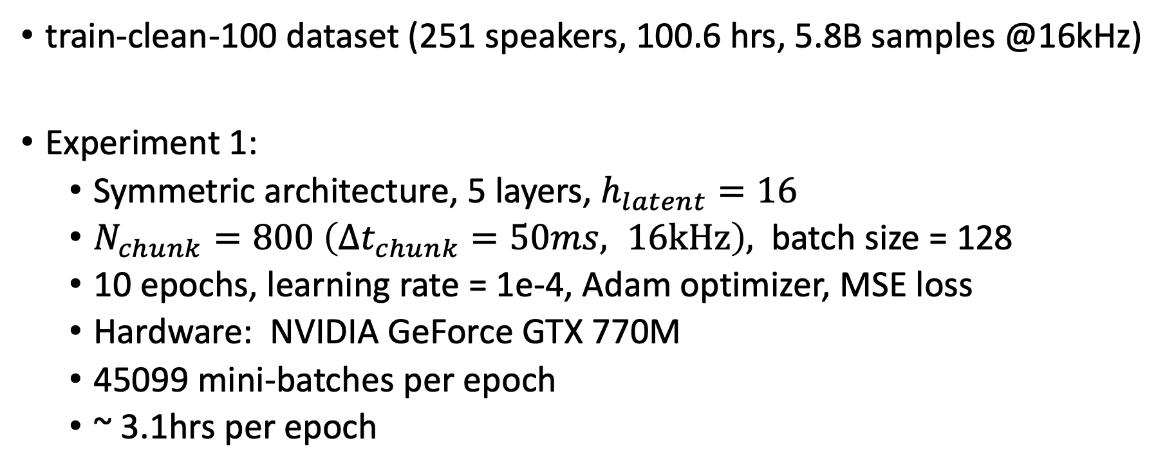
Training Experiment on Large Corpus
train-clean-100 dataset (251 speakers, 100.6 hrs, 5.8B samples @16kHz)
Experiment 1:
Symmetric architecture, 5 layers, $h_{latent}=16$
$N_{chunk}=800 \left({Δt}_{chunk}=50ms, 16kHz\right),$ batch size = 128
10 epochs, learning rate = 1e-4, Adam optimizer, MSE loss
Hardware: NVIDIA GeForce GTX 770M
45099 mini-batches per epoch
~ 3.1hrs per epoch

Slide 18
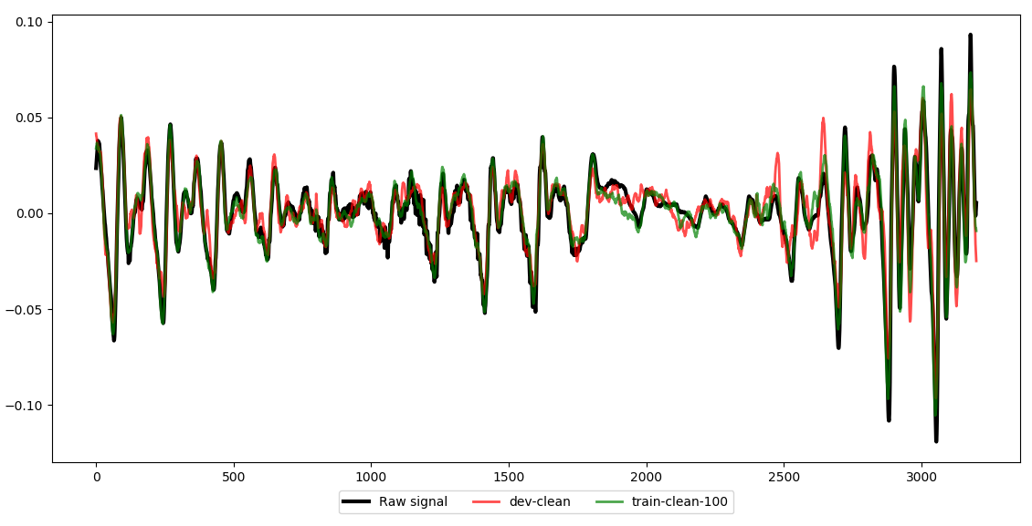

Training on Large Corpus
Speaker 2803
200ms audio sample (4 chunks)
$$N_{chunk}→N_{chunk}→\frac{N_{chunk}}{16}→{N_{chunk}→N}_{chunk}$$

Slide 19
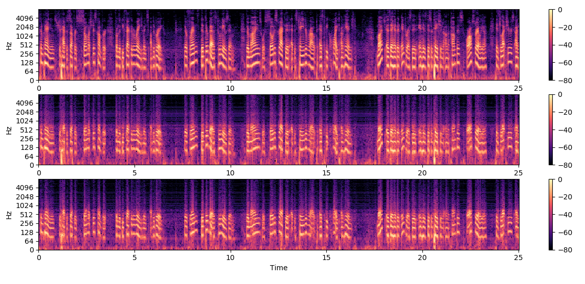
Training on Large Corpus
Speaker 2803
25s audio sample, log-spectrogram
Ground
Truth
dev-clean
100 epochs
train-clean-100
10 epochs

Slide 20
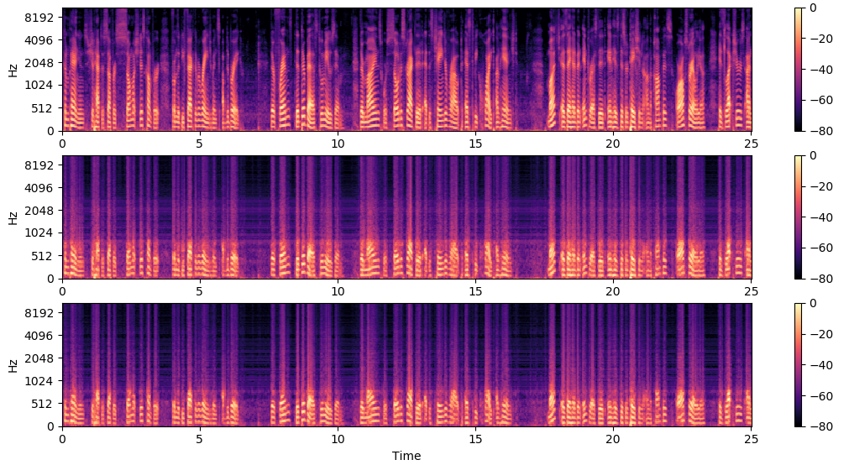
Training on Large Corpus
Speaker 2803
25s audio sample, mel-spectrogram
Ground
Truth
dev-clean
100 epochs
train-clean-100
10 epochs

Slide 21
Training on Large Corpus - observations
The networks trained on dev-clean and train-clean-100 produce almost identical reconstructions when viewed in the spectrograms.
It should be noted that training had not yet converged on the large corpus after 10 epochs.
It will be interesting to see if we can achieve high quality reconstructions with more severe latent size restrictions by employing deeper networks (7 or more layers) and training on the large corpus.

